Slide 1
ANALYSIS AND DESIGN
Analysis Modeling or Requirement modeling is a technical representation of the system.
It acts as a link between system description and design model.
In Analysis Modelling, information, behavior, and functions of the system are defined and translated into the architecture, component, and interface level design in the design modeling.

Slide 2
Analysis modeling can be
1. Scenario based modeling
2. Class based modeling
3. Flow oriented modeling

Slide 3
Scenario based Modeling
The Requirement modeling with UML begins with the creation of scenarios with the join of activity and use cases diagram.
Scenarios- specific purpose
• If the software engineer understand how end users want to interact with a system, the software team will be able to properly characterize requirements and build meaningful analysis and design models.

Slide 4
Analysis modeling with UML begins with the creation of scenarios in the form of uses-cases, activity diagram
Use-case Diagram for a SafeHome software
In general, use cases are written first in an informal narrative fashion
• Use case: Access camera surveillance via the Internet—display camera views
•Actor: homeowner
• The homeowner logs onto the SafeHome Products website. • The homeowner enters his or her user ID.
• The homeowner enters two passwords (each at least eight characters in length).

Slide 5
• The system displays all major function buttons.
• The homeowner selects the “surveillance” from the major function buttons.
• The homeowner selects “pick a camera.”
• The system displays the floor plan of the house.
• The homeowner selects a camera icon from the floor plan.
• The homeowner selects the “view” button.
• The system displays a viewing window that is identified by the camera ID.
• The system displays video output within the viewing window at one frame per second.

Slide 6
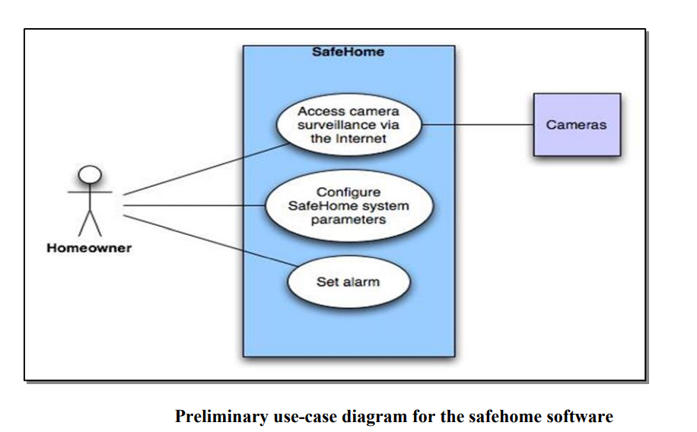
Alternative Actions • Can the actor take some other action at this point? • Is it possible that the actor will encounter some error condition at this point? • Is it possible that the actor will encounter behavior invoked by some event outside the actor’s control?

Slide 7
Activity diagram
• The UML activity diagram supplements the use-case by providing a graphical representation of the flow of interaction within a specific scenario
• Similar to flowchart an activity diagram uses rounded rectangles to imply a specify system functions, arrows to represent flow through the system, decision diamonds to depict a branching decision and solid horizontal lines to indicate that parallel activities are occurring

Slide 8
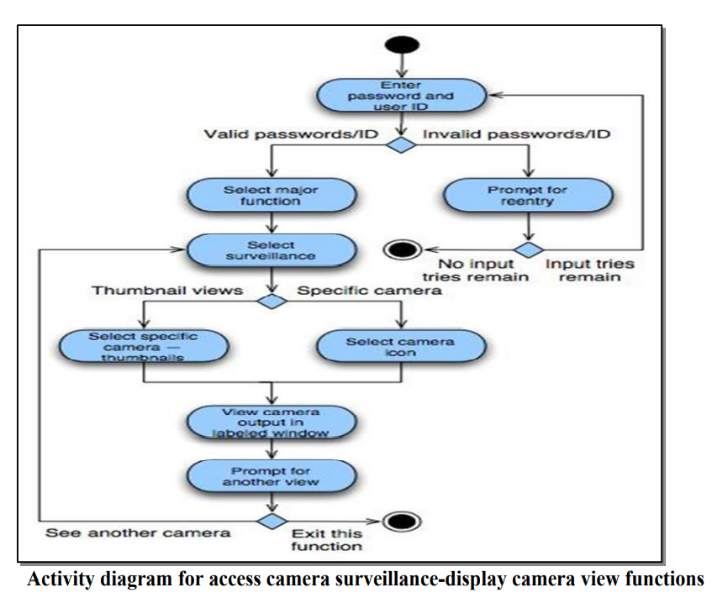

Slide 9
UML Modeling
A UML diagram is a diagram based on the UML (Unified ModelingLanguage) with the purpose of visually representing a system along with its main actors, roles, actions, artifacts or classes, in order to better understand, alter, maintain, or document information about the system.
There are three important types of UML modeling.
Structural modelling
Behavioural modelling
Architectural modelling

Slide 10
Structural Modeling
Structural modeling captures the static features of a system. Structural model represents the framework for the system and this framework is the place where all other components exist. Hence, the class diagram, component diagram and deployment diagrams are part of structural modeling. They all represent the elements and the mechanism to assemble them.
The structural model never describes the dynamic behavior of the system. Class diagram is the most widely used structural diagram.

Slide 11
.
Classes diagrams:
Class diagrams are the main building block of any object-oriented solution. It shows the classes in a system, attributes, and operations of each class and the relationship between each classes.
A class has three parts :
Name at the top
Attributes in the middle
Operations or methods at the bottom.

Slide 12
Objects diagrams:
Objects diagram, sometimes referred to as Instance diagrams are very similar to class diagram . Like class diagrams, they also show the relationship between objects but they use real-world examples.
Deployment diagrams:
A deployment diagram shows the hardware of your system and the software in that hardware. Deployment diagrams are useful when your software solution is deployed across multiple machines with each having a unique configuration. Below is an example deployment diagram.

Slide 13
Behavioural Modeling: Behavioural model describes the interaction in the system. It represents the interaction among the structural diagrams. Behavioural modeling shows the dynamic nature of the system. They consist of the following −
Activity diagrams
Interaction diagrams
Use case diagrams
All the above show the dynamic sequence of flow in a system.

Slide 14
Activity diagrams:
Activity diagrams represent workflows in a graphical way.
They can be used to describe the business workflow or the operational workflow of any component in a system. Sometimes activity diagrams are used as an alternative to State machine diagrams.
Interaction diagrams:
Interaction diagrams are very similar to activity diagrams. While activity diagrams show a sequence of processes, Interaction overview diagrams show a sequence of interaction diagrams.

Slide 15
Use case diagrams
Use case diagrams give a graphic overview of the actors involved in a system, different functions needed by those actors and how these different functions interact.
Architectural Modeling:
Architectural model represents the overall framework of the system. It
contains both structural and behavioral elements of the system.
Architectural model can be defined as the blueprint of the entire system.
Package diagram comes under architectural modeling.

Slide 16
Data modelling
Data modeling in software engineering is the process of creating a data model by applying formal data model descriptions using data modeling techniques. Data modeling is a technique for defining business requirements for a database
Data modelling is the process used to structure how data is stored, as well as modelling relationships within the data.
The goal is to create a visual data map that accurately describes the data structure, how data will flow through the system whilst highlighting important data relationships.

Slide 17
Data Objects:
A data object is a representation of Composite information that must be understood by software.
A data object can be external entity (eg.,anything that produces or consumed information), a thing (eg., a report or a display), an occurance (eg., a telephone call) or event(eg., an alarm), a role(eg., salesperson), an organizational unit (eg., accounting department), a place (eg., warehouse), or a structure (eg., a file).
A data object encapsulates data only, there is no reference within a data objects.
For example, a person or a car can be viewed as a data object in the sense that either can be defined in terms of a set of attributes. The description of the data object incorporates the data object and all of its attributes.

Slide 18
Structural Modeling:
Structural modeling captures the static features of a system. Structural model represents the framework for the system and this framework is the place where all other components exist. Hence, the class diagram, component diagram and deployment diagrams are part of structural modeling. They all represent the elements and the mechanism to assemble them.
The structural model never describes the dynamic behavior of the system. Class diagram is the most widely used structural diagram.
Classes diagrams:
Class diagrams are the main building block of any object-oriented solution. It shows the classes in a system, attributes, and operations of each class and the relationship between each classes.
A class has three parts :
Name at the top
Attributes in the middle
Operations or methods at the bottom.

Slide 19
Data Attributes :
Data attributes define the properties of a data object and take one of three different characteristics. They can be used to
Name an instance of the data objects.
Describe the instance.
Make reference to another instance in another table.
In addition, one or more of the attributes must be defined as an identifier, where the identifier attributes becomes a key attributes when we want to find an instance of the data objects.

Slide 20
The values of the identifier must be unique, although this is not a requirement. The set of attributes that is appropriate for a given data object is determined through an understanding of the problem context.
The attributes for car might serve well for an application that would be used by a department of motor vehicles, but these attributes would be useless for an automatic company that needs manufacturing control software.
To reduce the redundancy and to provide consistency in table these data objects tables are formalized by applying a set of normalization rules that will result in a relational model for the data. These normalization rules are:

Slide 21
A given instance of adata objects has one and only one value for each objects.
Attributes represent elementary data items they should contain no internal structure.
When more than one attributes is used to identify a data objects be sure that descriptive and referential attributes represent a characteristics of the entire objects and not a characteristic of some things that would be identified by only part of the identifier.
All non identifierattributes must represent some characteristic of the instance named by the identifier of the data objects and describe some other attributes that is not an identifier.

Slide 22
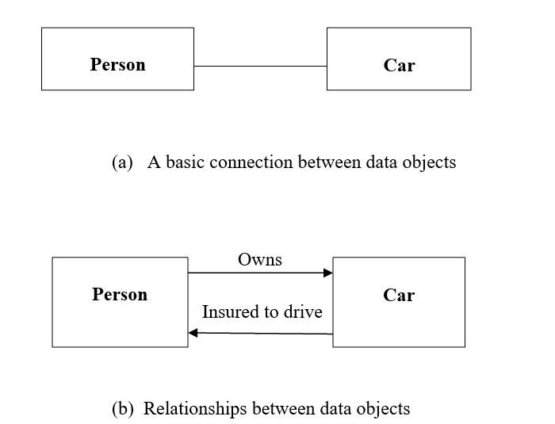
Relationships :
Data objects are connected to one another in different ways. Consider the two data objects, person and car. These objects can be represented using the simple notation.

Slide 23
A connection is established between person and car because the two objects are related.
For example,
A person owns a car.
A person is insured to drive a car.
The relationships own and insured to drive define the relevant connections between person and car. It provide important information about the directionality of the relationship and often reduce ambiguity and misinterpretations.

Slide 24
What is data modeling in software engineering and Explain its types.
Data modelling is the process used to structure how data is stored, as well as modelling relationships within the data. The goal is to create a visual data map that accurately describes the data structure, how data will flow through the system whilst highlighting important data relationships.
Types of Data Models:
There are mainly three different types of data models:
1. Conceptual Data models
2. Logical Data models,
3. Physical Data models.

Slide 25
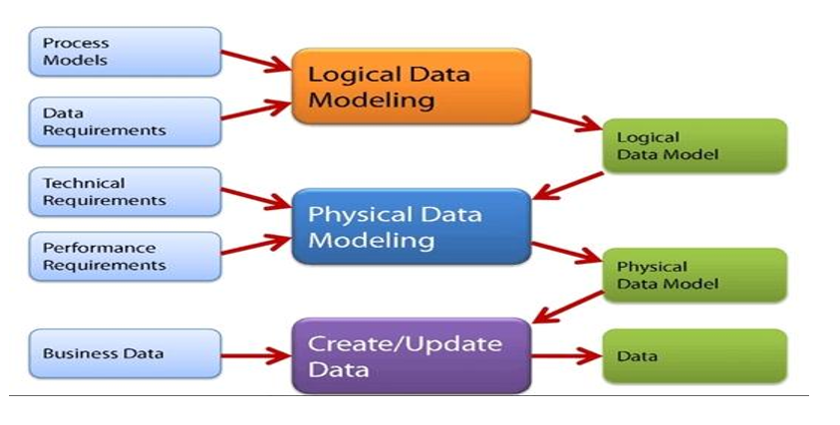

Slide 26
1. Conceptual Data models: This Data Model defines WHAT the system contains. This model is typically created by Business stakeholders and Data Architects. The purpose is to organize, scope and define business concepts and rules.
2. Logical Data Model: Defines HOW the system should be implemented regardless of the DBMS. This model is typically created by Data Architects and Business Analysts. The purpose is to developed technical map of rules and data structures.
3. Physical Data Model: This Data Model describes HOW the system will be implemented using a specific DBMS system. This model is typically created by DBA and developers. The purpose is actual implementation of the database.

Slide 27
Explain about dataflow diagrams with suitable example.
Data-flow diagrams:
Data-flow diagrams (DFDs) model a perspective of the system that is most readily understood by users – the flow of information through the system and the activities that process this information.
Data-flow diagrams provide a graphical representation of the system that aims to be accessible to computer specialist and non-specialist users alike.
The models enable software engineers, customers and users to work together effectively during the analysis and specification of requirements.
Although this means that our customers are required to understand the modeling techniques and constructs, in data-flow modeling only a limited set of constructs are used, and the rules applied are designed to be simple and easy to follow.
These same rules and constructs apply to all data-flow diagrams (i.e., for each of the different software process activities in which DFDs can be used).

Slide 28
As can be seen, the DFD notation consists of only four main symbols:
Processes — the activities carried out by the system which use and transform information. Processes are notated as rectangles with three parts, such as “Order Supplies” and “Make Payments” in the above example.
Data-flows — the data inputs to and outputs from to these activities. Data-flows are notated as named arrows, such as “Delivery” and “Supply Order” in the example above.
External entities — the sources from which information flows into the system and the recipients of information leaving the system. External entities are notated as ovals, such as “Supplier” in the example above.
Data stores — where information is stored within the system. Data stores are notated as rectangles with two parts, such as “Supplier Details” and “Orders” in the example above.

Slide 29
The diagrams are supplemented by supporting documentation including a data dictionary, describing the contents of data-flows and data stores; and process definitions, which provide detailed descriptions of the processes identified in the data-flow diagram.

Slide 30
Data Modeling: Data modeling is the process of creating a simplified diagram of a software system and the data elements it contains, using text and symbols to represent the data and how it flows.
Modeling concepts:
Data Objects :A data object can be an external entity , a thing ,an occurrence or event ,a role, an organizational unit, a place, or a structure.
Data Attributes :Data attributes define the properties of a data object.
They can be used to (1) name an instance of the data object,
(2) describe the instance, or (3) make reference to another instance in another table.
In addition, one or more of the attributes must be defined as an identifier—that is, the identifier attribute becomes a "key" when we want to find an instance of the data object.

Slide 31
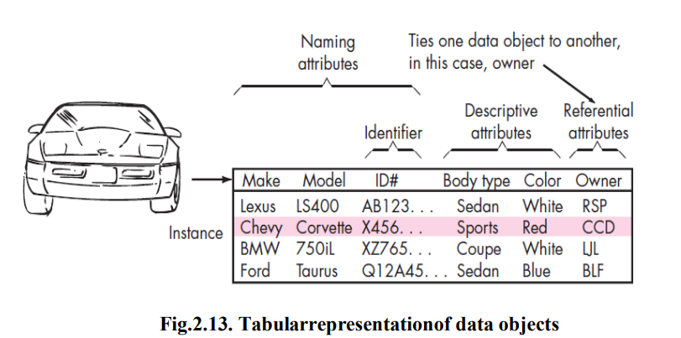
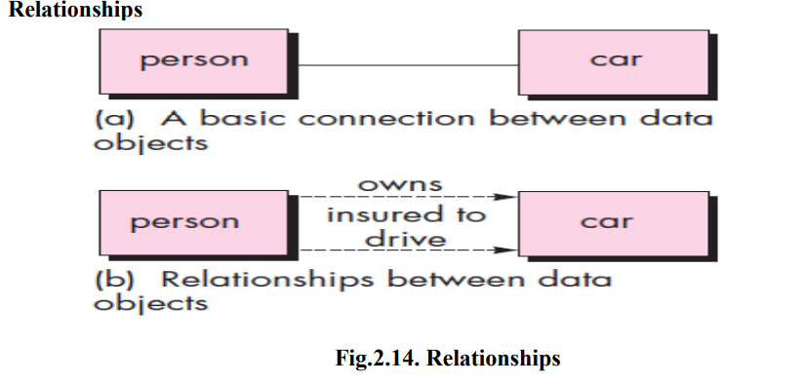

Slide 32
Data objects are connected to one another in different ways. Consider the two objects person and car ,a connection is established between them because they are related. For example
A person owns a car
A person is insured to drive a car.
Cardinality and Modality
We must understand how many occurrences of object X are related to how many occurrences of objectY.
This leads to a data modeling concept called cardinality.

Slide 33
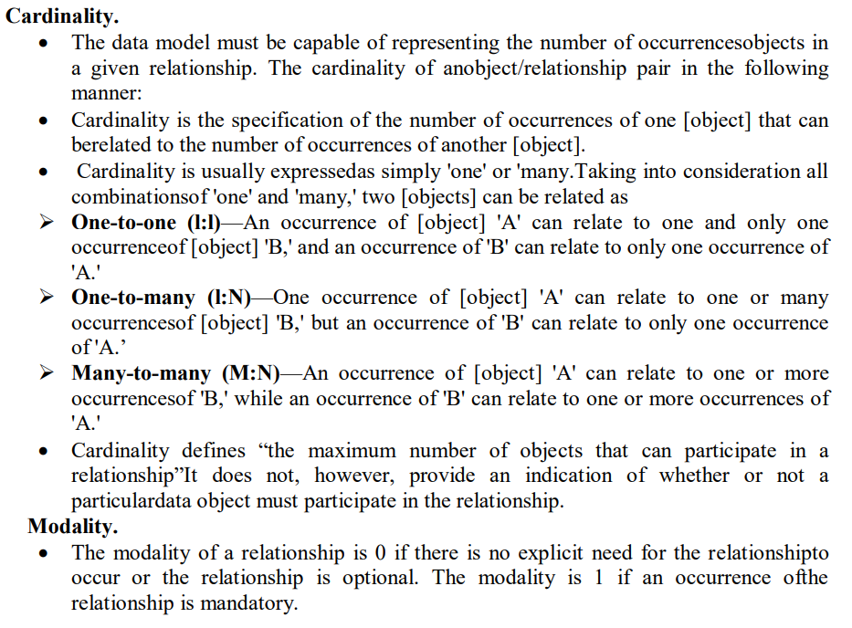

Slide 34
Flow-Oriented Modeling
A Data Flow Diagram (DFD) is a traditional visual representation of the information flows within a system. A neat and clear DFD can depict the right amount of the system requirement graphically.
The objective of a DFD is to show the scope and boundaries of a system as a whole.
It may be used as a communication tool between a system analyst and any person who plays a part in the order that acts as a starting point for designing a system.
The DFD is also called as a data flow graph or bubble chart.

Slide 35
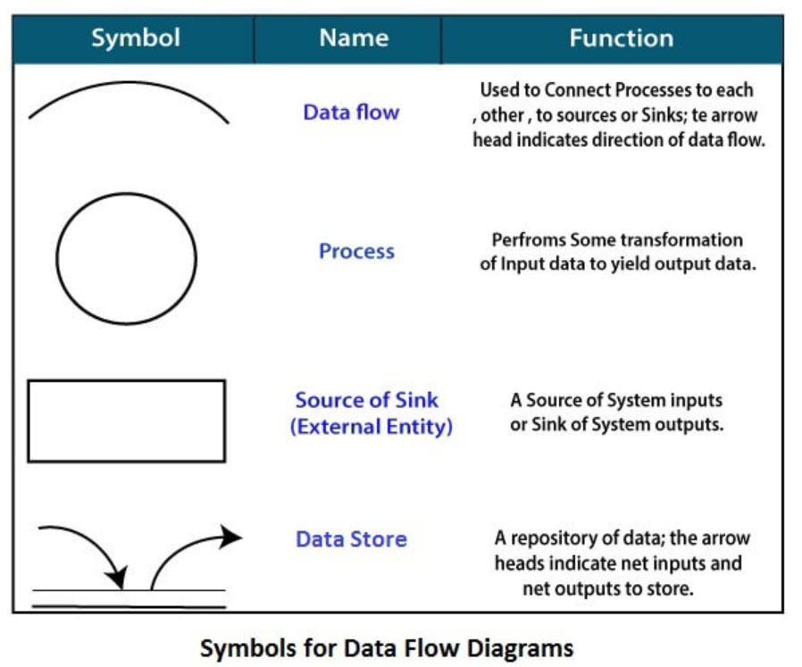

Slide 36
Circle: A circle (bubble) shows a process that transforms data inputs into data outputs.
Data Flow: A curved line shows the flow of data into or out of a process or data store.
Data Store: A set of parallel lines shows a place for the collection of data items. A data store indicates that the data is stored which can be used at a later stage or by the other processes in a different order. The data store can have an element or group of elements.
Source or Sink: Source or Sink is an external entity and acts as a source of system inputs or sink of system outputs.

Slide 37
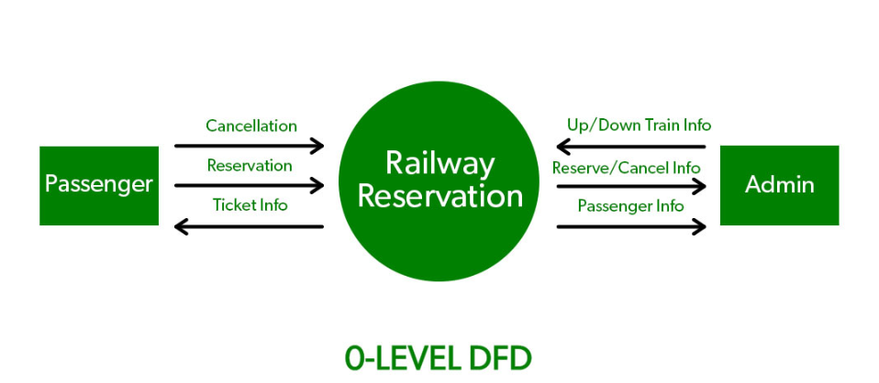
0-level DFD: It is also known as a context diagram. It’s designed to be an abstraction view, showing the system as a single process with its relationship to external entities. It represents the entire system as a single bubble with input and output data indicated by incoming/outgoing arrows.

Slide 38
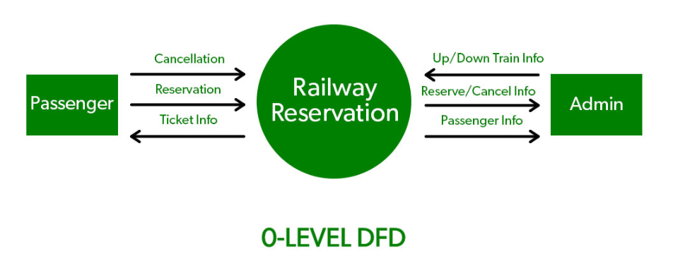
Levels in Data Flow Diagrams (DFD)
In Software engineering DFD(data flow diagram) can be drawn to represent the system of different levels of abstraction.
Higher-level DFDs are partitioned into low levels-hacking more information and functional elements.
Levels in DFD are numbered 0, 1, 2 or beyond. Here, we will see mainly 3 levels in the data flow diagram, which are: 0-level DFD, 1-level DFD, and 2-level DFD.

Slide 39
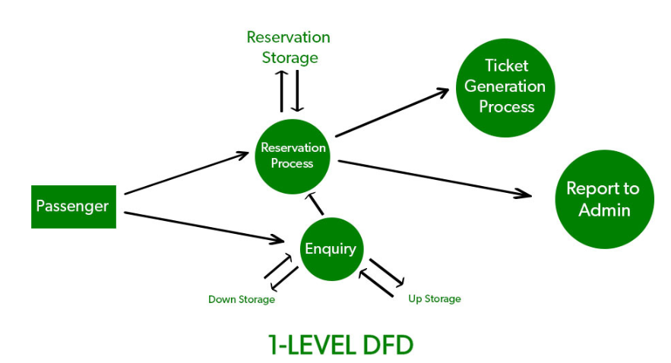
1-level DFD: In 1-level DFD, the context diagram is decomposed into multiple bubbles/processes. In this level, we highlight the main functions of the system and breakdown the high-level process of 0-level DFD into subprocesses.

Slide 40
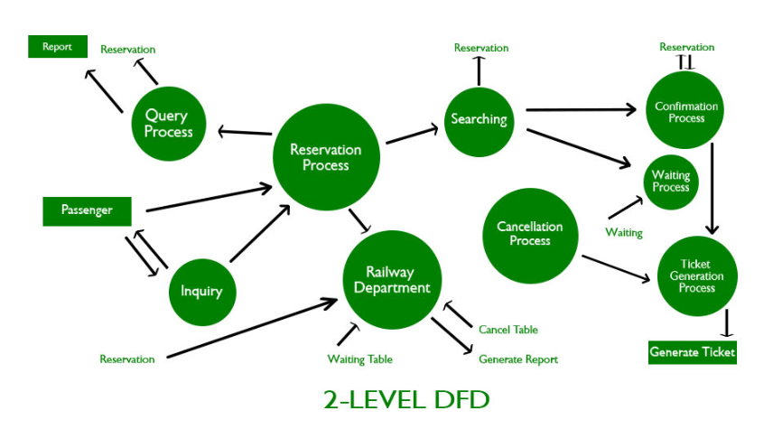
2-level DFD: 2-level DFD goes one step deeper into parts of 1-level DFD. It can be used to plan or record the specific/necessary detail about the system’s functioning.

Slide 41
Purpose of Class Diagrams
Shows static structure of classifiers in a system
Diagram provides a basic notation for other structure diagrams prescribed by UML
Helpful for developers and other team members too
Business Analysts can use class diagrams to model systems from a business perspective
A UML class diagram is made up of:
A set of classes and
A set of relationships between classes

Slide 42
What is a Class
A description of a group of objects all with similar roles in the system, which consists of:
Structural features (attributes) define what objects of the class "know"
Represent the state of an object of the class
Are descriptions of the structural or static features of a class
Behavioral features (operations) define what objects of the class "can do"
Define the way in which objects may interact
Operations are descriptions of behavioral or dynamic features of a class
Class Notation
A class notation consists of three parts:
Class Name
The name of the class appears in the first partition.
Class Attributes
Attributes are shown in the second partition.
The attribute type is shown after the colon.
Attributes map onto member variables (data members) in code.
Class Operations (Methods)
Operations are shown in the third partition. They are services the class provides.
The return type of a method is shown after the colon at the end of the method signature.
The return type of method parameters is shown after the colon following the parameter name.
Operations map onto class methods in code

